Slide 1

A comparative Analysis of NLP models for Resume Screening
Team:
SAILEELA URUVAKILI
JAHNAVI GARIKAPATI

Slide 2
Project objectives
Create multiple NLP models to screen resumes based on job descriptions and evaluate their performance.
Reduce the manual workload by automating resume filtering, making the hiring process faster and more efficient.
Implement standardized screening criteria to enhance fairness in candidate selection.
Provide candidates with a transparent, objective evaluation process, helping them align resumes effectively with job requirements.

Slide 3
Review of the State of the Art
Brief Overview of Resume screening:
NLP-based resume screening automates candidate selection by analyzing text in resumes, helping organizations filter applicants based on skills and experience, while reducing manual effort and enhancing objectivity.
Traditional: Keyword matching is widely used but often overlooks candidates with different terminology.
ML and NLP Integration: Advanced models like TF-IDF, Word2Vec, and BERT capture context, enhancing screening accuracy.
Hybrid Models: Combining NLP with rule-based criteria allows more tailored candidate filtering.
Emerging Trends:
Semantic Matching: Context-aware models like BERT improve matching.
Bias Reduction: Models aim to minimize demographic bias.
Candidate Feedback: Tools give resume alignment insights.

Slide 4
Approach
Algorithms, Datasets, Models, Tools, and Techniques:
Algorithms: Utilize pre-trained transformer models like BERT and RoBERTa for semantic matching in resumes.
Datasets: Use diverse resume datasets and job description corpora
Models: Compare the performance of BERT, RoBERTa, DistilBERT, and a traditional model TF-IDF.
Tools: Implement models using Hugging Face's Transformers library.
Techniques: Analyze model outputs, assess attention mechanisms, and explore fine-tuning strategies..

Slide 5
Algorithms
Logistic Regression:
Logistic regression is a simple yet effective linear model used in resume screening to classify candidates as suitable or not based on features like skills, experience, and keywords. It provides interpretable results, helping identify which features are most influential.
Random Forest:
Random Forest is an ensemble learning method that uses multiple decision trees to improve accuracy and handle non-linear relationships in resume data. Its feature importance metrics can highlight key attributes that differentiate strong candidates, making it robust for complex datasets.

Slide 6
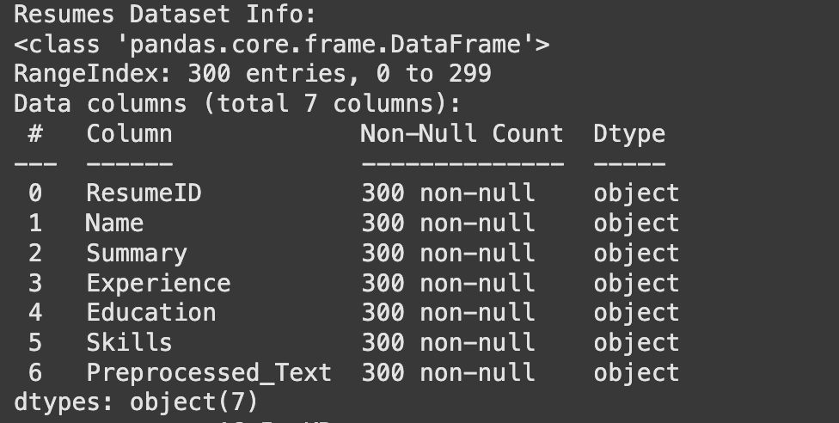
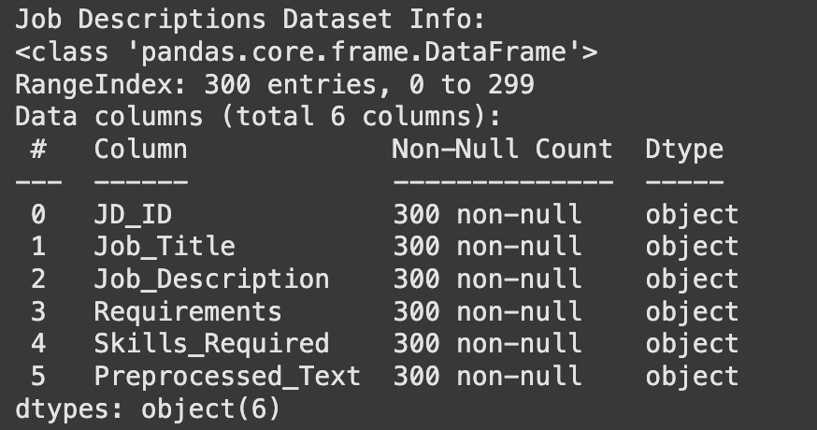
Datasets
Resumes : Job Descriptions :

Slide 7
Models
Logistic Regression with TF-IDF (Term Frequency-Inverse Document Frequency): TF-IDF is a statistical method that evaluates the importance of words in a document relative to a collection of documents. For resume screening, it extracts relevant keywords from resumes and job descriptions, allowing for basic matching based on term significance without understanding the context.
BERT (Bidirectional Encoder Representations from Transformers): BERT is a pre-trained deep learning model that excels in understanding the context of words in a sentence. In resume screening, BERT can capture the nuanced meaning of skills, roles, and qualifications, enabling accurate matching between resumes and job descriptions.
RoBERTa (Robustly Optimized BERT Pretraining Approach): An optimized version of BERT, RoBERTa enhances performance by training on more data and removing unnecessary constraints. In resume screening, it provides deeper contextual understanding, improving candidate-job fit by identifying subtler matches.
DistilBERT: A lightweight and faster version of BERT, DistilBERT maintains much of BERT's performance while being computationally efficient. It’s ideal for resume screening systems where real-time or resource-constrained processing is needed, enabling effective and quick candidate matching.

Slide 8
Logistic Regression with TF-IDF (Term Frequency-Inverse Document Frequency):
Results and Evaluation:
Metric | Class 0 | Class 1 | Accuracy | Macro Avg | Weighted Avg
Precision | 0.46 | 0.52 | - | 0.49 | 0.49
Recall | 0.64 | 0.33 | - | 0.49 | 0.48
F1-Score | 0.53 | 0.41 | - | 0.47 | 0.47
Support | 42 | 48 | - | 90 | 90
Overall Accuracy | - | - | 0.48 | - | -

Slide 9
BERT (Bidirectional Encoder Representations from Transformers):
Results and Evaluation:
Metric | Value
Evaluation Loss | 0.6289330720901489
Evaluation Accuracy | 0.5833333333333334
Precision | 0.5
Recall | 0.16
F1 Score | 0.24242424242424243

Slide 10
RoBERTa (Robustly Optimized BERT Pretraining Approach):
Results and Evaluation:
Epoch | Training Loss | Validation Loss | Accuracy | Precision | Recall | F1 Score
1 | 0.683600 | 0.675425 | 0.579778 | 0.584879 | 0.732119 | 0.650268

Slide 11
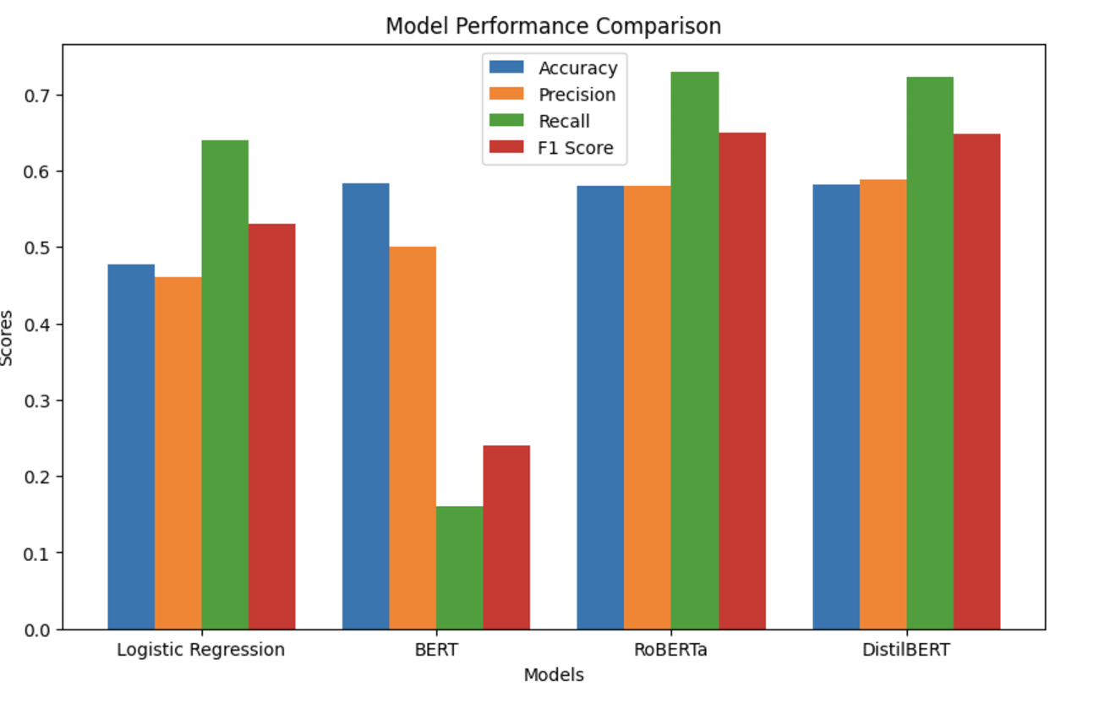
Comparison:
This visual compares the performance of Logistic Regression, BERT, RoBERTa DistilBERT models across evaluation metrics:
RoBERTa is the most robust model for this task, followed by BERT, with Logistic Regression being less effective overall.

Slide 12
Conclusion:
RoBERTa demonstrates the best overall performance across all metrics, excelling in precision and F1 score. BERT also performs well, particularly in accuracy and recall, while Logistic Regression, though interpretable, lags behind the transformer-based models. DistilBERT offers a balance between efficiency and performance, making it suitable for resource-constrained scenarios. These results highlight that advanced models like RoBERTa and BERT are more effective for intelligent resume screening tasks.

Slide 13
Deliverables
Datasets: Curated resume and job description datasets.
Comparative Analysis Report: Detailed performance analysis of each pre-trained model.
Visualizations: Graphs showing attention weights and model decision-making processes.
Codebase: Organized code for model implementation and analysis.

Slide 14
Evaluation Methodology
Metrics : Curated resume and job description datasets.
Comparative Analysis Report: Detailed performance analysis of each pre-trained model.
Visualizations: Graphs showing attention weights and model decision-making processes.
Documentation: Clear presentation of limitations and challenges

Slide 15
References:
BERT: Pre-training of Deep Bidirectional Transformers for Language Understanding
https://arxiv.org/abs/1810.04805
Research Papers and Articles:
Devlin, J., Chang, M. W., Lee, K., & Toutanova, K. (2019). BERT: Pre-training of Deep Bidirectional Transformers for Language Understanding. arXiv:1810.04805
Liu, Y., Ott, M., Goyal, N., et al. (2019). RoBERTa: A Robustly Optimized BERT Pretraining Approach. arXiv:1907.11692
Libraries and Frameworks:
Hugging Face Transformers Documentation. Available at: https://huggingface.co/transformers/
Scikit-learn Documentation: https://scikit-learn.org
Evaluation Metrics:
Precision, Recall, and F1 Score Overview: https://en.wikipedia.org/wiki/Precision_and_recall
TF-IDF Methodology: Manning, C. D., Raghavan, P., & Schütze, H. (2008). Introduction to Information Retrieval. Cambridge University Press.

Slide 16
Thank you

